Slide 1
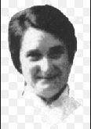
Gladys Aylward
Missionary to Yangcheng China
1902-1970

Slide 2
Trailblazers: Flight of the Fugitives
By Dave and Neta Jackson
The story is about Gladys Aylward and her missionary work at the Inn of Eight Happinesses in China.

